Slide 1
Accelerating Search-Based Planning for Multi-Robot Manipulation by Leveraging Online-Generated Experiences
Team:
Bhaswanth Ayapilla
Anirudh Srihari
Oliver Berton
Nikhil Sobanbabu
Kailash Jagadeesh

Slide 2
Motivation

Slide 3
Motivation
Problem:
Multi-arm robotic manipulation enables collaborative tasks, but requires collision-free, coordinated motion planning in high-dimensional joint spaces.
Classical planners (RRT-Connect, PRM) struggle in tightly constrained, multi-robot setups, often failing to find valid solutions.
CBS-based planners (CBS, ECBS) provide conflict-resolution and theoretical guarantees, but suffer from slow performance due to repeated low-level replanning.
Project Goal:
Implement and benchmark RRT-Connect, CBS, ECBS, and xECBS in MuJoCo to analyze their:
Planning efficiency
Collision handling ability
Path quality
Scalability with number of manipulators

Slide 4
Approach

Slide 5
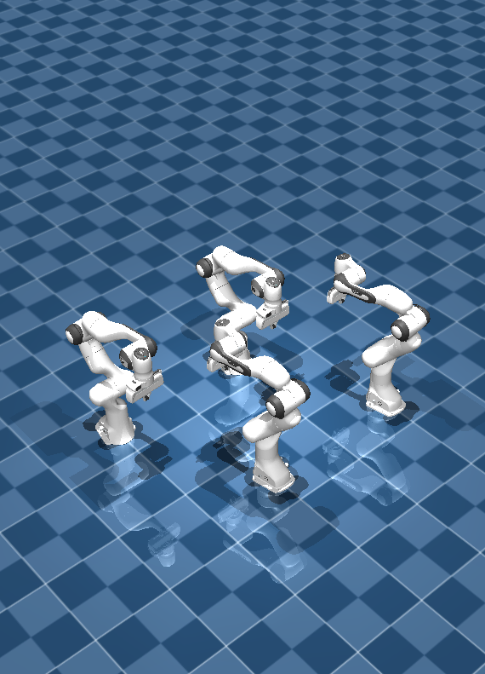
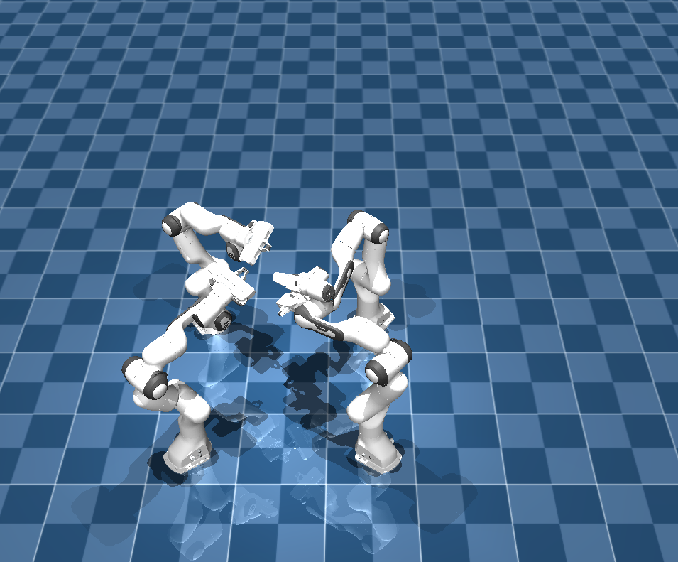
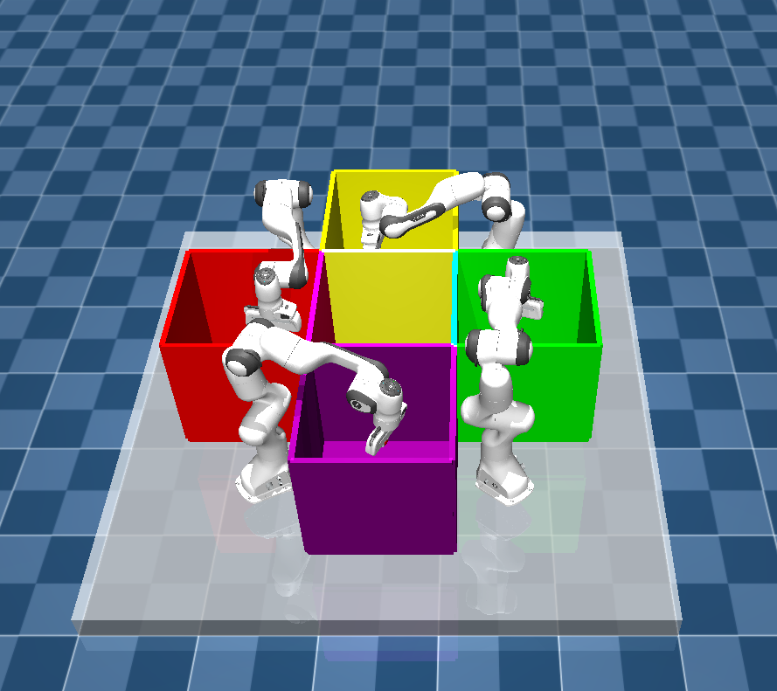
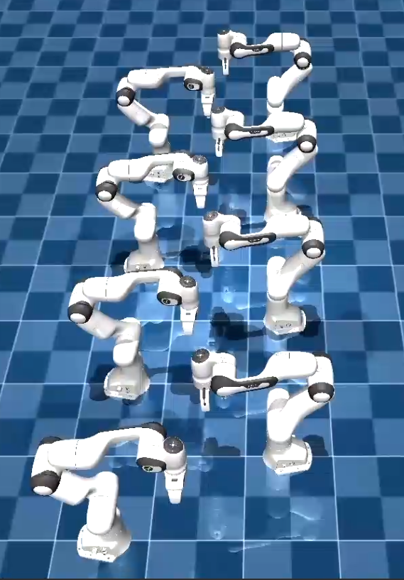
The Scene

Slide 6

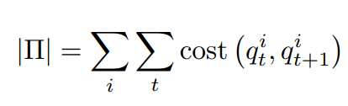
Math Definition
Problem Setup:
Robots: n manipulators, configuration spaces
Composite space:
Goal: find collision-free joint path
minimizing

Slide 7

RRT-Connect

Slide 8
CBS
High Level Search:
Search over set of constraints, priority determined by lower bound on path costs returned by low-level planner
Independent low-level planner for each agent subject to constraints
When a conflict is found, the high level branches into two child nodes, each adding a constraint to one of the conflicting agents
Replan only agent that receives new constraints
Low-Level Search: A*
Lattice-Based Graph
Implicit Construction
Successors correspond to small rotations of each joint + staying stationary
Heuristic: L1 distance between current and goal joint angles

Slide 9
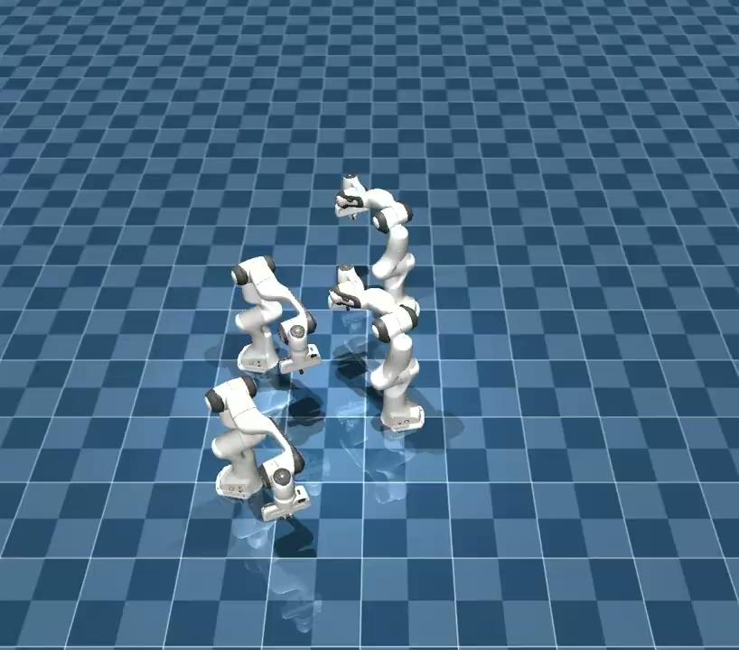
CBS

Slide 10






ECBS
High-Level Focal Search:
Primary Cost:
where lower bound returned by LL planner.
Primary cost is used to build the focal set:
HL Search expands nodes from focal set in order of secondary heuristic
Conflict resolution: add constraint c replan only for agent i(c)
Low-Level Search: Weighted A*
Weighted A* priority:
Returns: LL cost lower bound returned:
No experience reuse in ECBS (this is the key difference vs xECBS).

Slide 11
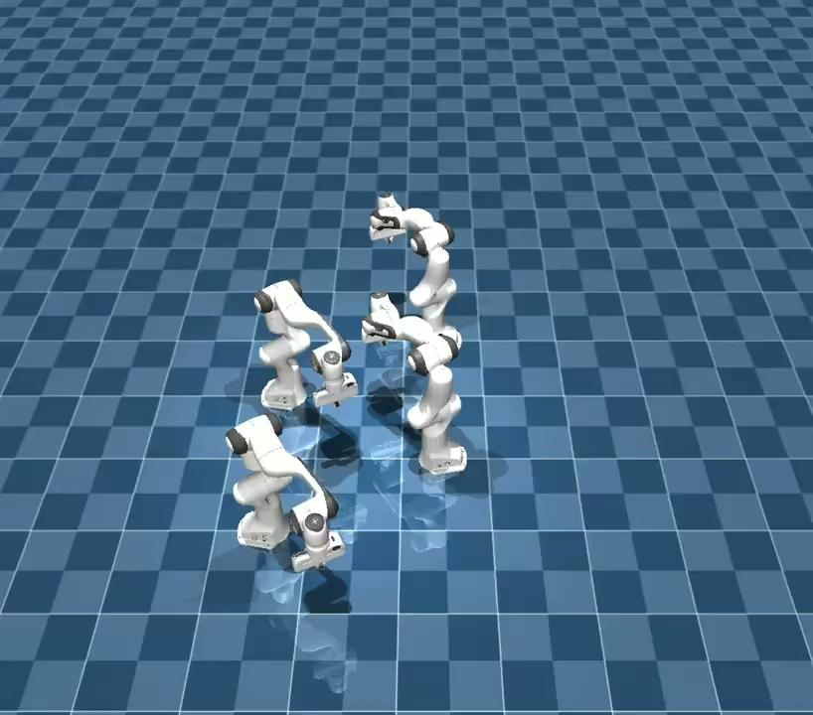
ECBS

Slide 12

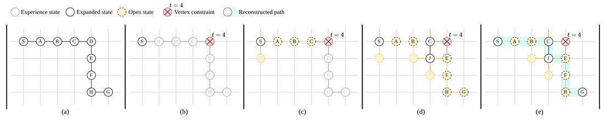
xECBS
High-Level Focal Search:
Similar to ECBS high-level search
Build FOCAL set using criterion:
Expand path from focal set with closest secondary heuristic
When expanding: cache copy of previously computed path as experience and pass into lower level planner
Low-Level Search: xWA*
When expanding states:
If state belongs to experience path: add as much of the experience as possible to the open list. Add consecutive states into open until termination criterion (i.e. constraint) is met
Figure from Shaoul et al 2024

Slide 13


xECBS
High-Level Focal Search:
HL priority:
where lower bound returned by LL planner.
Focal condition:
Conflict resolution: add constraint c replan only for agent i(c)
Low-Level Search Weighted A*
Weighted A* priority:
FOCAL selection:
Inject experience path into OPEN whenever expanded node lies on

Slide 14
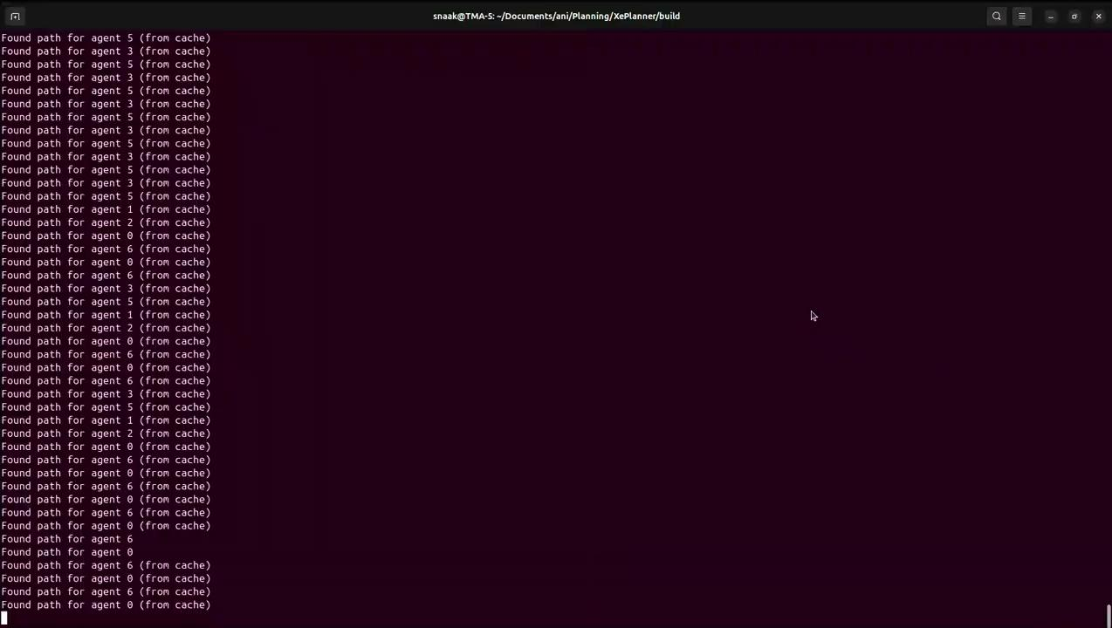
xECBS
Live - Demo

Slide 15
Results

Slide 16
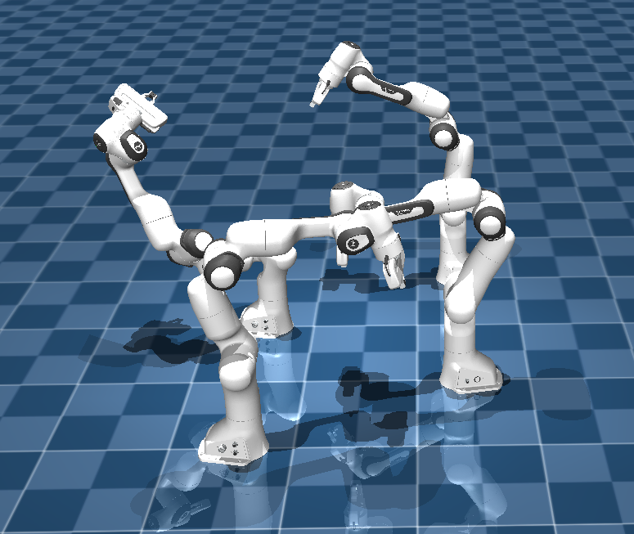
Metrics
Scene 1 - Random Configs:
Planner | Success | Planning Time (sec) | Cost
xECBS | 9/20 | 18.43+-15.48 | 2497+-404.51
ECBS | 11/20 | 34.15+-36.34 | 2417.01+-405.61
CBS | 8/20 | 21.02 +-16.72 | 2402.87+-328.91
RRT-Connect | 2/20 | 60.85+-34.59 | N/A
Scene 2 - 8 arms:
Planner | Success | Planning Time (sec) | Cost
xECBS | Yes | 136.81 | 2148
ECBS | Yes | 462.79 | 2176
CBS | No | N/A | N/A
RRT-Connect | No | N/A | N/A

Slide 17
Metrics
Scene 3 - 4 arms:
Planner | Success | Planning Time (sec) | Cost
xECBS | Yes | 12.935 | 1109
ECBS | Yes | 18.182 | 1091
CBS | Yes | 26.94 | 1109
RRT-Connect | No | N/A | N/A
Scene 4 - 4 arms criss cross:
Planner | Success | Planning Time (sec) | Cost
xECBS | Yes | 10.81 | 1288
ECBS | Yes | 21.94 | 1285
CBS | No | 21.67 | 1290
RRT-Connect | No | N/A | N/A

Slide 18
(a)
(b)
(c)
(d)

Slide 19
Conclusion

Slide 20
Conclusion
Project Takeaways:
Our benchmarking in MuJoCo highlights the clear performance gap between classical planners (RRT-Connect) and conflict-based planners.
Experience-accelerated approach (xECBS) consistently offers the best balance of speed, solution quality, and robustness in multi-arm environments.
These results reinforce that experience reuse is a key direction for scalable, real-world multi-robot motion planning.

Slide 21
Thank you!

